Slide 1
CHB Decoration Item Phase 2
Wall Size:
2/F:
1: 4830mmW x 2395mmH (90mm牆腳線)
2: 780mmW x 2550mmH
3: 1110mmW x 470mmH &
580mmW x 470mmH
4: 560mmW x 490mmH &
1300mmW x 490mmH
3/F:
5: 2530mmW x 2590mmH
4/F:
6: 530mmW x 2305mmH (100mm牆腳線)
7: 873mmW x 2305mmH (100mm牆腳線)
Balcony:
8: 1360mmW x 2210mmH
9: 1380mmW x 2185mmH
Notes:
4/F:
6: 530mmW x 2305mmH (100mm牆腳線)
7: 873mmW x 2305mmH (100mm牆腳線)
Balcony:
8: 1360mmW x 2210mmH
9: 1380mmW x 2185mmH

Slide 2
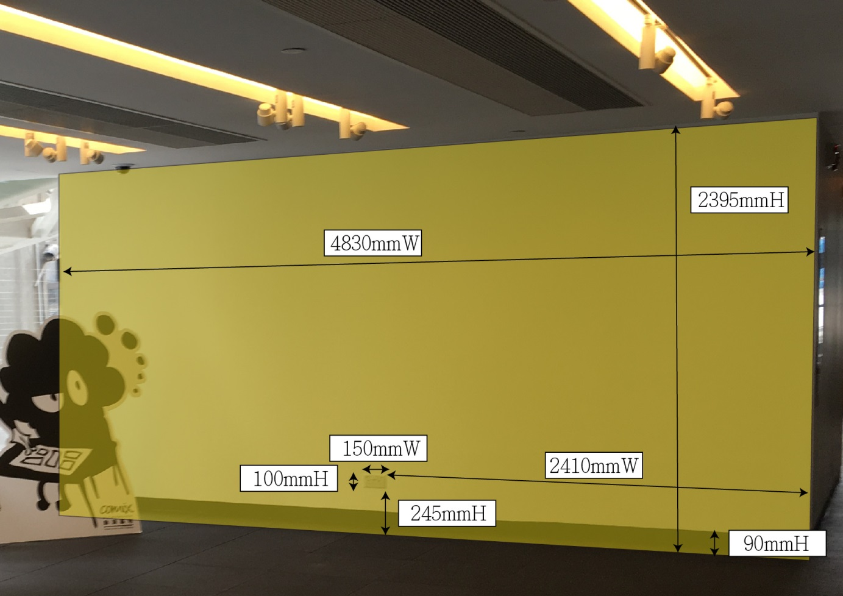
2/F Lobby
1
Wall Size:
1: 4830mmW x 2395mmH
(90mm牆腳線)

Slide 3
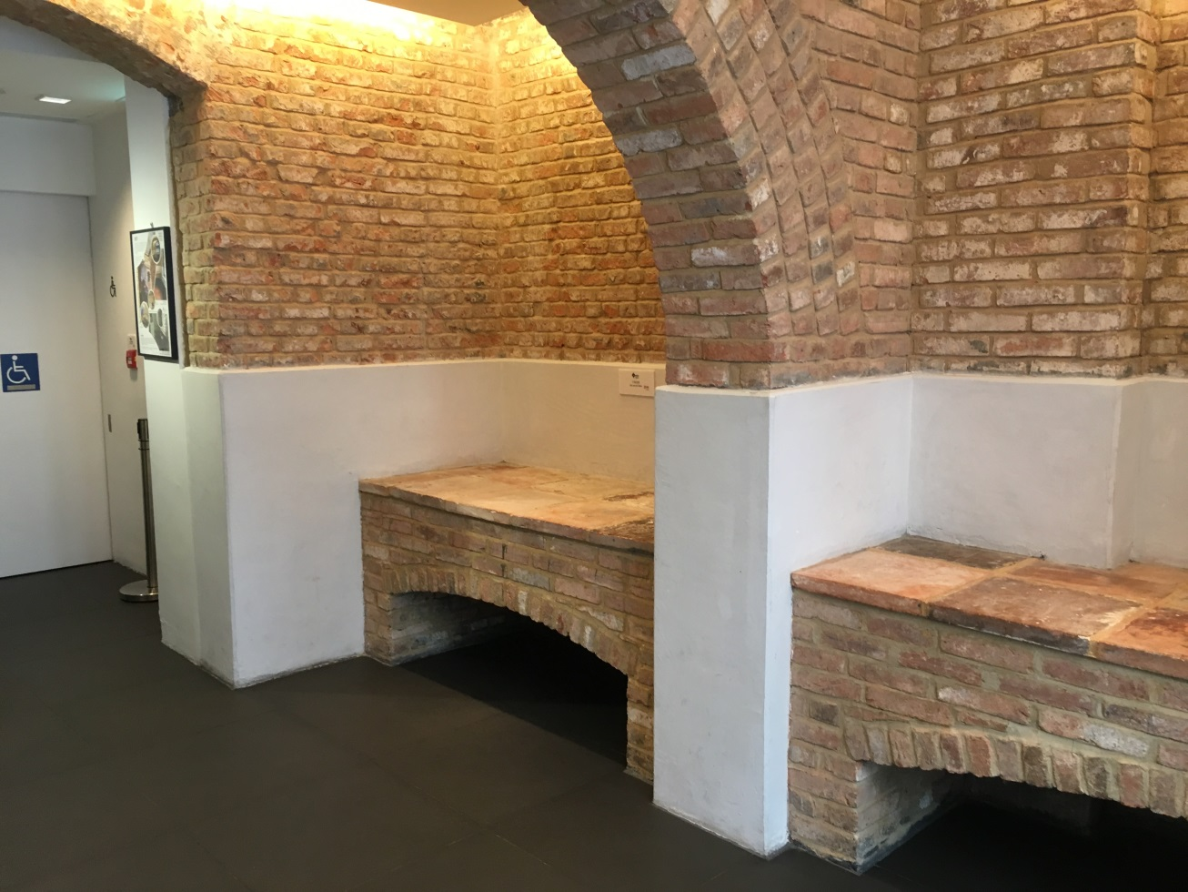
2/F Kitchen
2
3
4

Slide 4
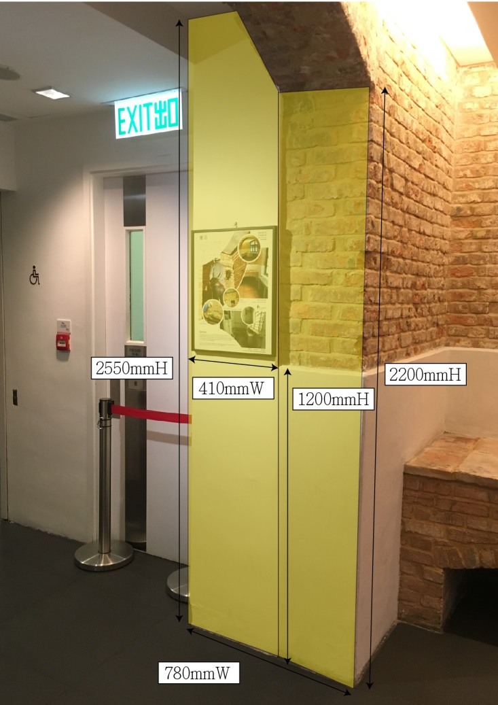
2/F Kitchen
2
Wall Size:
2: 780mmW x 2550mmH
Notes:
5070mmW x 2900mmH
3400mmW x 2900mmH

Slide 5
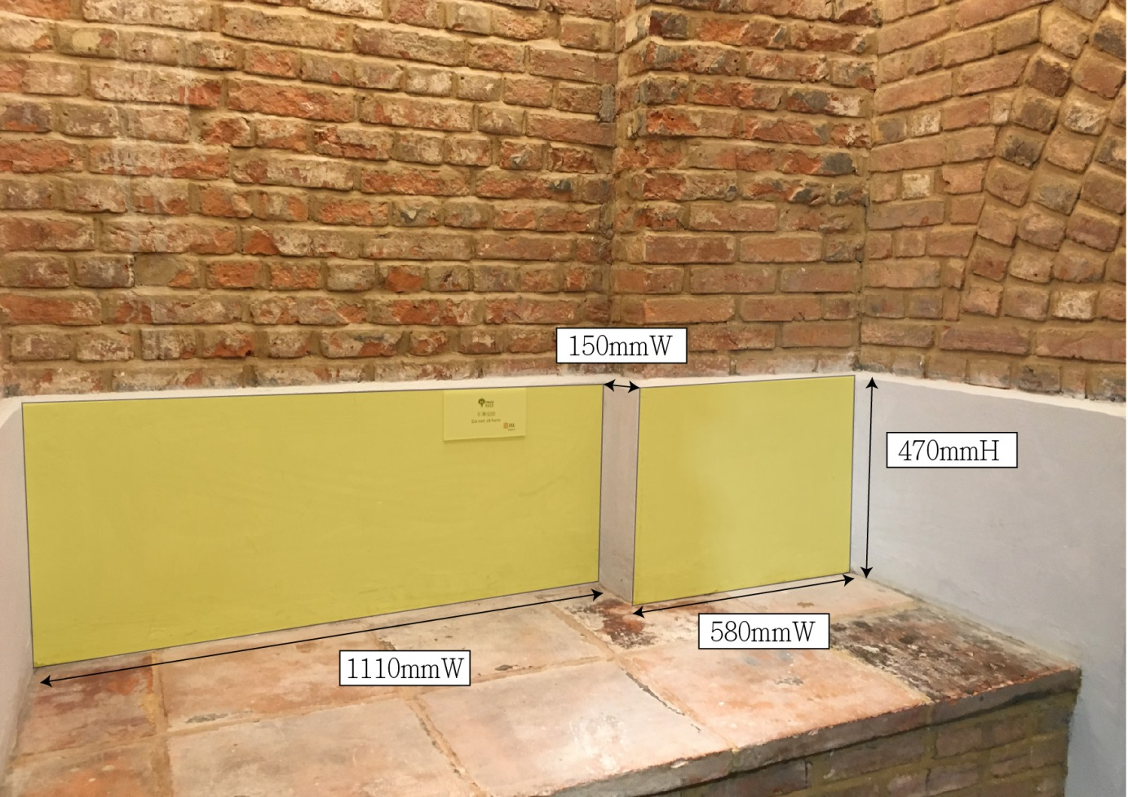
2/F Kitchen
Wall Size:
3: 1110mmW x 470mmH &
580mmW x 470mmH
3

Slide 6
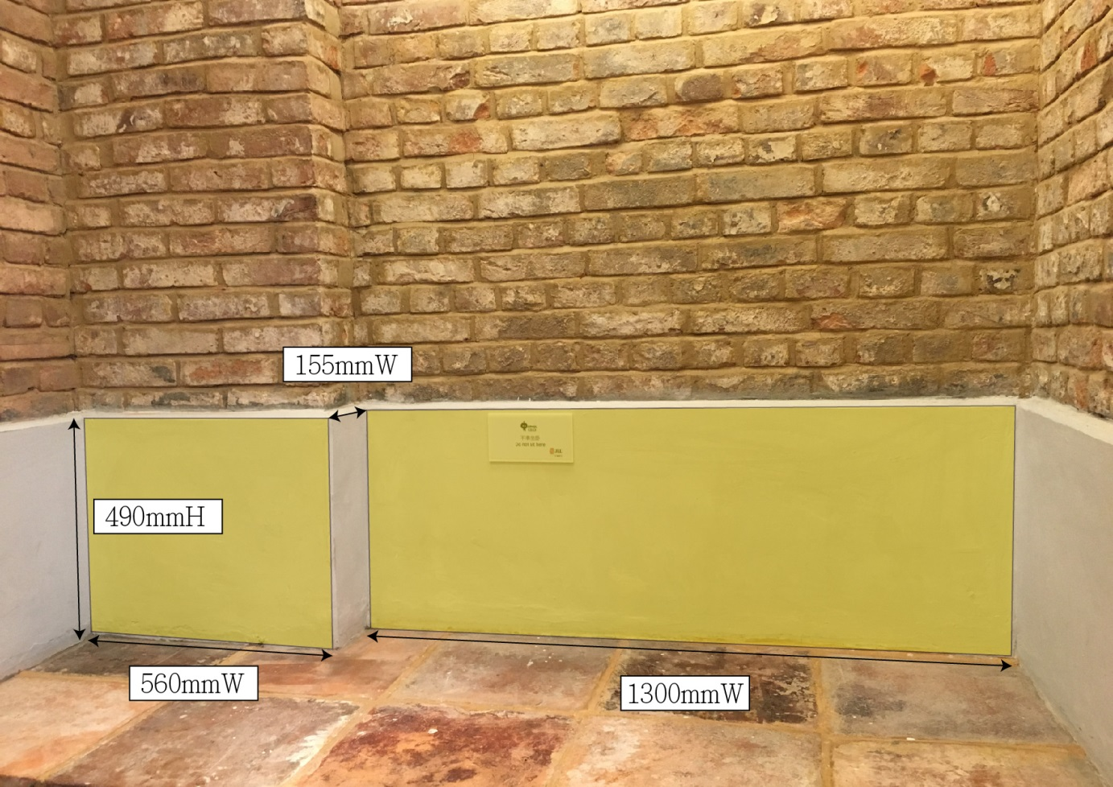
2/F Kitchen
Wall Size:
4: 560mmW x 490mmH &
1300mmW x 490mmH
4

Slide 7
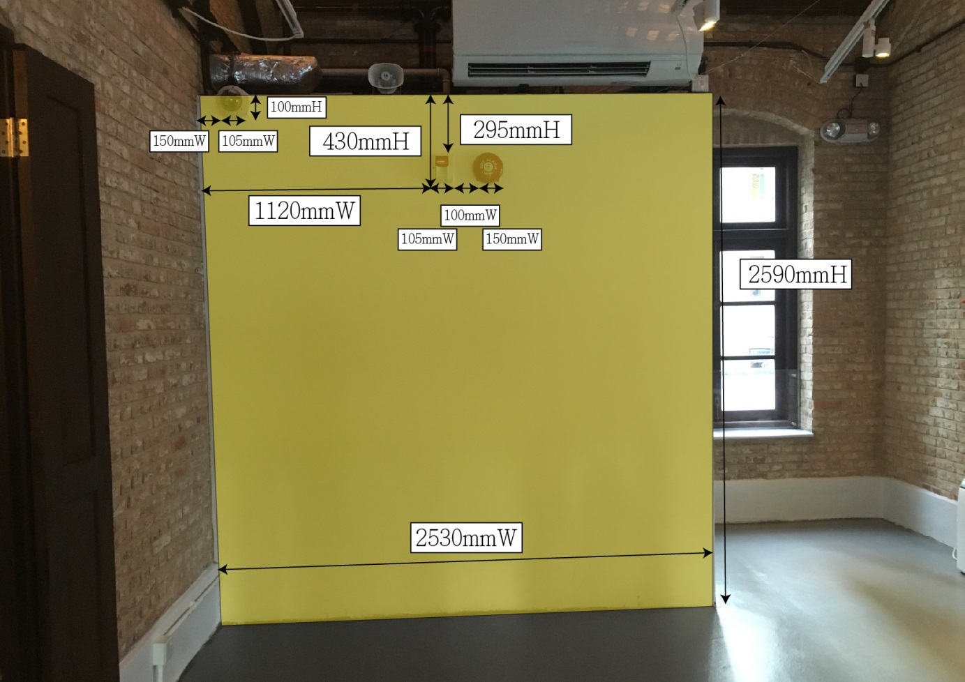
3/F Master Wall
5
Wall Size:
5: 2530mmW x 2590mmH

Slide 8
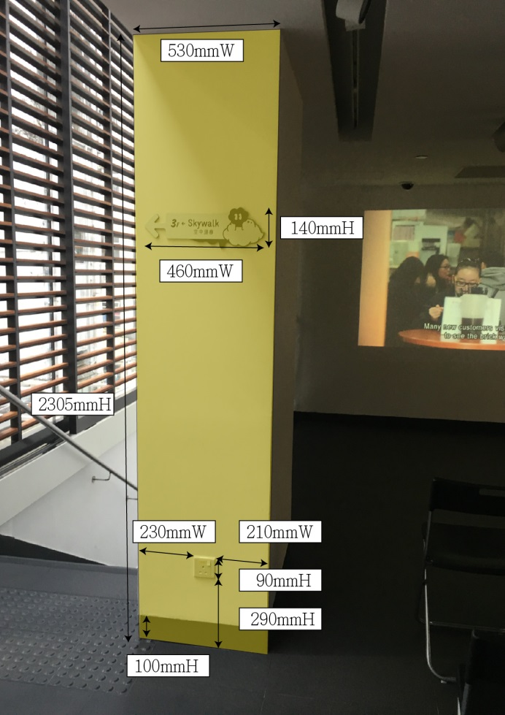
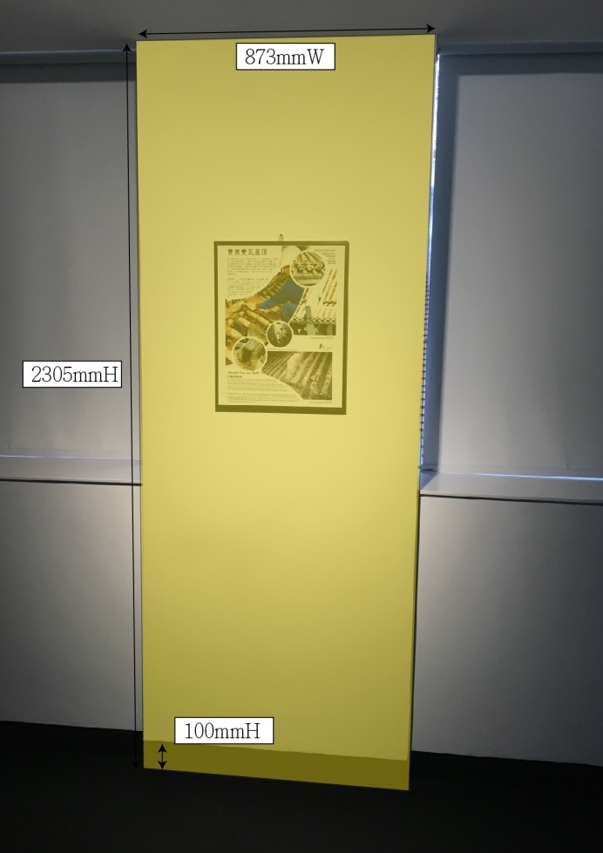
4/F
6
7
Wall Size:
6: 530mmW x 2305mmH
(100mm牆腳線)
7: 873mmW x 2305mmH
(100mm牆腳線)

Slide 9
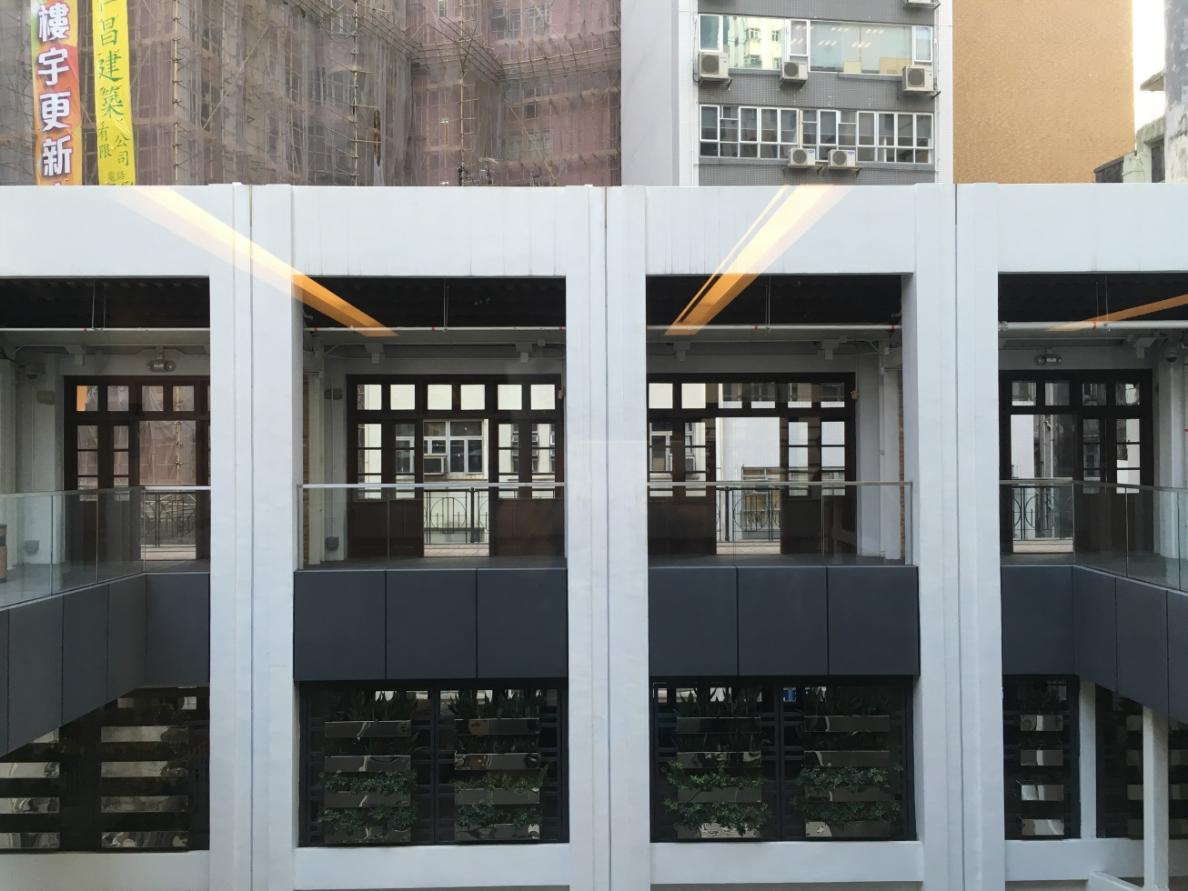
Balcony:
8
9

Slide 10
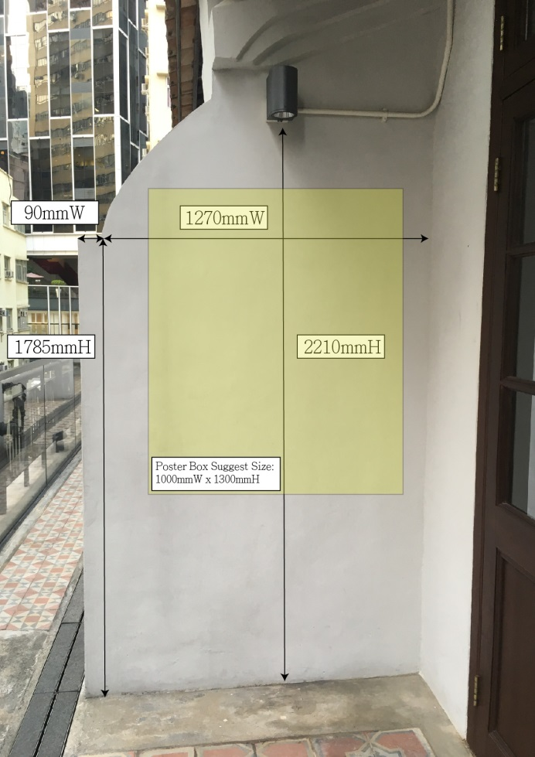
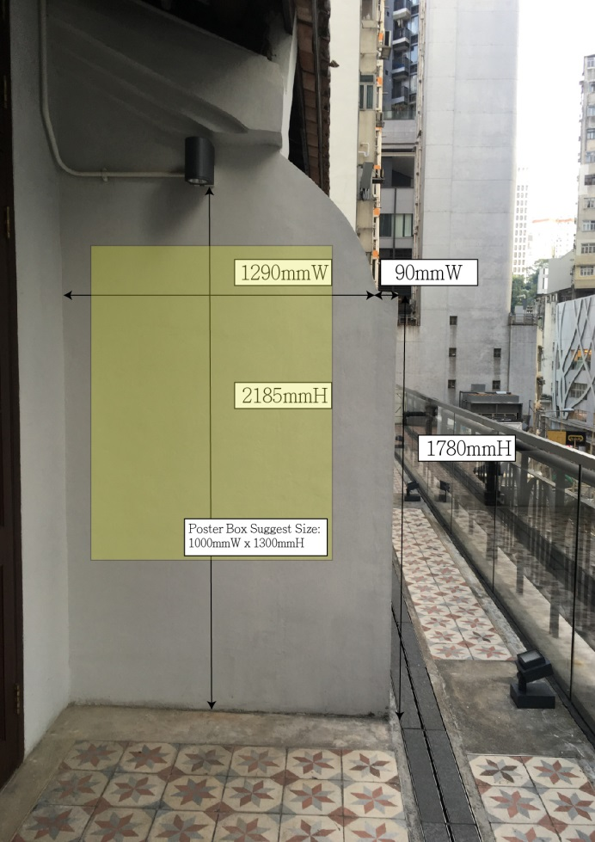
4/F
8
9
Wall Size:
8: 1360mmW x 2210mmH
9: 1380mmW x 2185mmH

